Slide 1
Chapter 7
Review

Slide 2
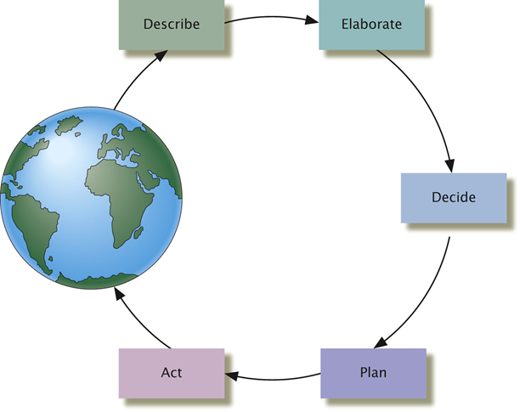
The five core functions of thought
Describe incoming information
Elaborate on it
Decide what to do
Plan how to do it
Act on the plan

Slide 3
Ingredients of thoughts, esp. concepts, schema,
Concept: artifitial vs. natural
Schema: Generalizations about categories of objects, places, events, and people (role schema and event schema)

Slide 4
Three types of heuristics
The anchoring bias: Getting stuck on (anchored to) prior information
The Representativeness bias: Judging that something belongs to a certain group because of its similarity to some group members
The availability heuristic: Judgment based on ease of calling something to mind

Slide 5
Confirmation bias
A tendency to find evidence which confirms our beliefs, and to ignore or discount evidence which is contrary to them
Based on the anchoring heuristic

Slide 6
Why we make bad decisions?
Expected value = odds of gain * value of gain
We wrongly estimate the odds and the value (e.g., Overestimate probability of unlikely events; Underestimate probability of likely events; Gambler’s fallacy)

Slide 7
Basic elements of language
Symbol
Grammar
Phoneme
Morpheme
Words
Phrases and sentences

Slide 8
Stages of language development.
Babbling
One-word
Two-word
Three-word
Acquire most of the syntax by 5 years old

Slide 9
Stages of Language Development
What are the characteristics at each stage?
First year: babbling
Second year: one-word stage, two-word stage
Third year: begin to use auxiliary verbs, “wh-” questions

Slide 10
Classifying intelligence
Cattell’s theory
Sternberg’s Triarchic Theory of Intelligence
Gardner’s Multiple Intelligence Theory

Slide 11
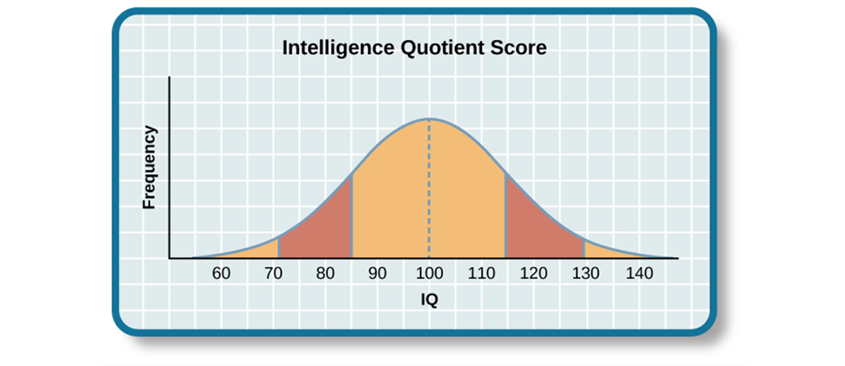
The Bell Curve
Average of IQ score: 100
82% of the population: 85-100

Slide 12
Source of Intelligence
Minnesota Study of Twins Reared Apart: revealed a genetic component of intelligence
Environment also plays a role

